Slide 1
TechiNar Series
Unit Testing Frameworks
May 20th, 2014
By Ayaz Lakdawala

Slide 2


Slide 3
Agenda
Differences between JUnit 3.x, JUnit 4.x and Spock
New Features provided by JUnit 4
New Features provided by Spock
Upcoming Hot TechiNarS
3rd Party Libraries
Credits
Demo
References
Q and A

Slide 4

DIFFERENCES

Slide 5
Test Class definition
Junit 3.x
Junit 4.x
Spock

Slide 6



Method names
Junit 3.x : Test method name should start with “test”
Junit 4.x
Spock

Slide 7
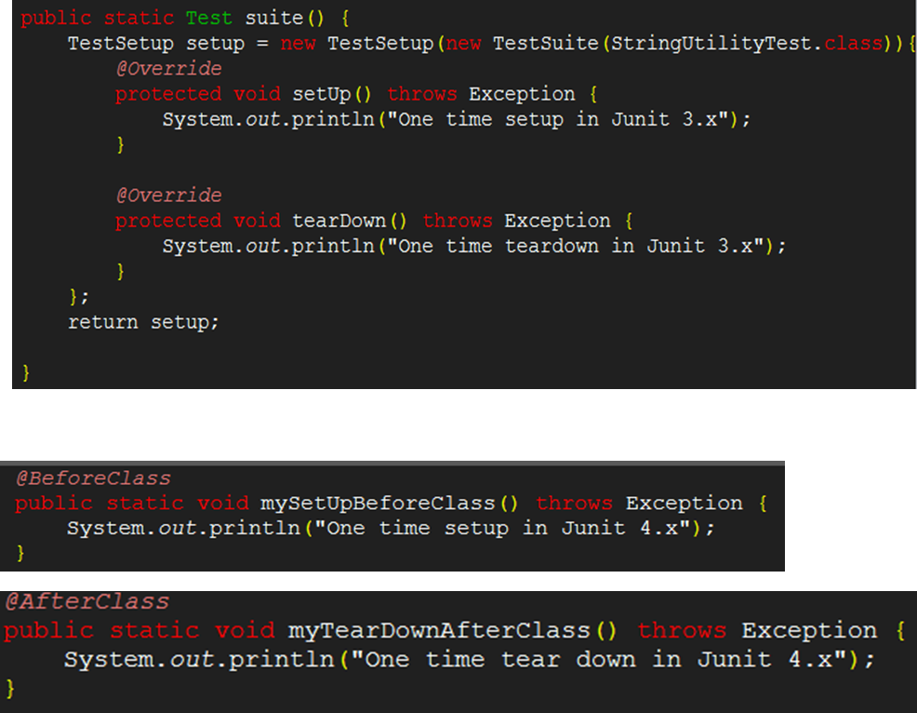
Differences (Contd..)
One Time setup and tear down:
JUnit 3.x
JUnit 4.x

Slide 8


Differences (Contd..)
One Time setup and tear down:
Spock : using setupSpec() and cleanupSpec() methods

Slide 9
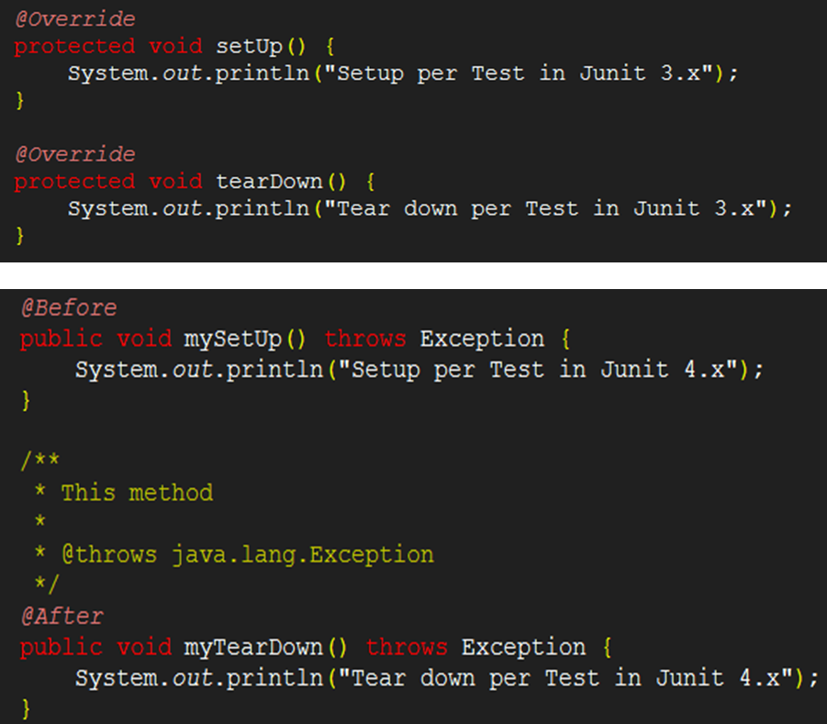
Differences (Contd..)
SetUp and TearDown per test:
JUnit 3.x
JUnit 4.x

Slide 10


Differences (Contd..)
SetUp and TearDown per test:
Spock : using setup() and cleanup() methods

Slide 11


Differences (Contd..)
Assert Statements:
JUnit 3.x
Functionality provided by base-class (junit.framework.Assert) of TestCase class.
JUnit 4.x
Provides additional functionality to asset arrays.(assertArrayEquals)
Specific asset statements can be imported statically.
Spock
Uses equal-to comparator “==“ to assert
Notes:
Assert Statements:
Junit 3.x uses inherited assert Methods of TestCase class
Junit 4.x uses statically imported assert Methods from Assert class directly.
Ignoring tests
No direct way to ignore tests in Junit 3.x except for renaming the tests.

Slide 12
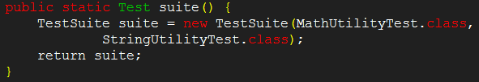

Differences (Contd..)
Test Suite:
JUnit 3.x
JUnit 4.x
Spock : No direct way. Tests can be run using Gradle or with @SuitClasses Junit annotation.
Notes:
Test Suite:
Junit 3.x uses TestSuite class.
Junit 4.x uses Suite Runner and @SuiteClasses annotation.

Slide 13
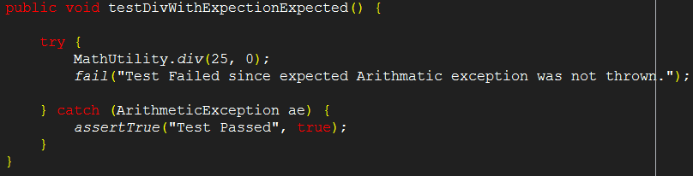

Differences (Contd..)
Testing Exceptions:
JUnit 3.x
JUnit 4.x
Notes:
Testing Exceptions:
Junit 3.x uses try-catch.
Junit 4.x uses expected attribute of @Test annotation.

Slide 14
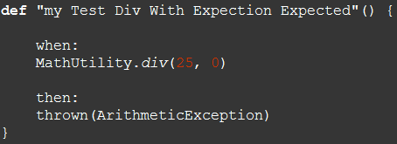
Differences (Contd..)
Testing Exceptions:
Spock : using thrown

Slide 15
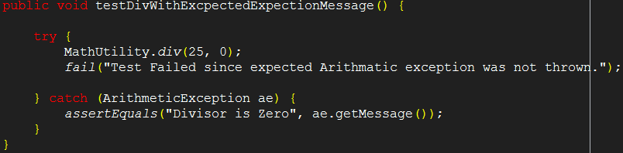
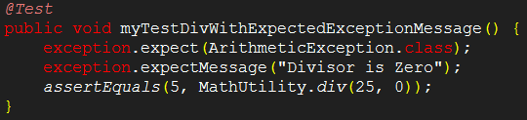
Differences (Contd..)
Testing Exceptions with messages:
JUnit 3.x
JUnit 4.x
Notes:
Testing Exceptions with messages:
Junit 3.x uses try-catch.
Junit 4.x uses @Rule annotation.

Slide 16
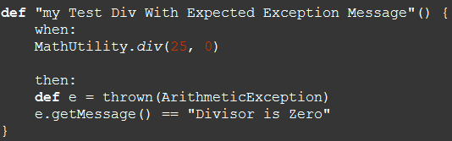
Differences (Contd..)
Testing Exceptions with messages:
Spock : using thrown

Slide 17
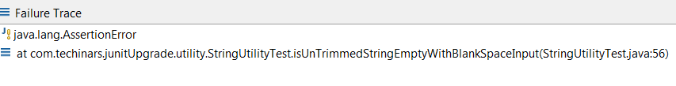
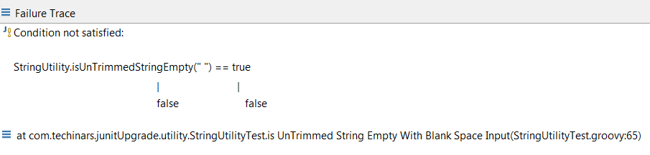
Differences (Contd..)
Error Reporting :
JUnit
Spock

Slide 18

NEW FEATURES BY JUnit 4

Slide 19
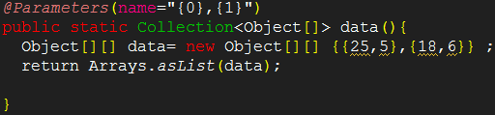

Parameterized Testing with Parameterized Runner :

Slide 20

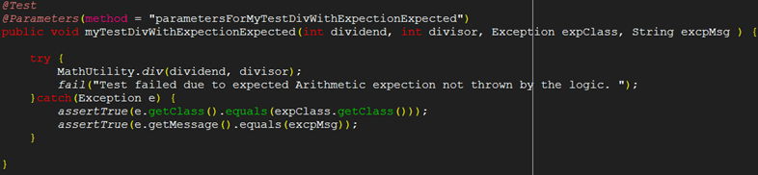
New Features BY JUnit 4 (Contd..)
Parameterized Testing with JunitParamsRunner :

Slide 21

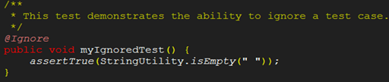
New Features BY JUnit 4 (Contd..)
Spring JUnit Testing:
Ignoring tests

Slide 22
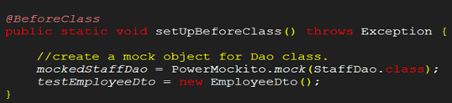
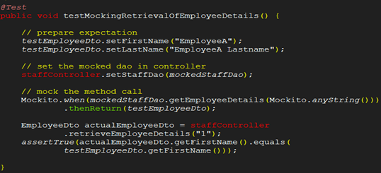
New Features BY JUnit 4 (Contd..)
Mocking using
PowerMockito:

Slide 23
NEW FEATURES BY Spock

Slide 24
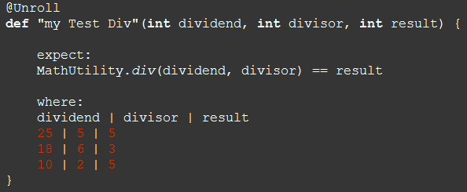
Parameterized Testing :

Slide 25
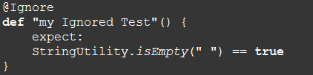
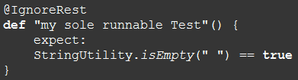
New Features BY Spock (Contd..)
Spring Spock Testing:
Ignoring tests
Ignoring single test
Ignoring all the tests except the test method marked with @IgnoreRest

Slide 26
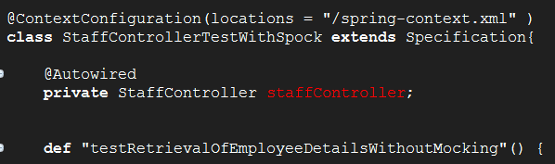
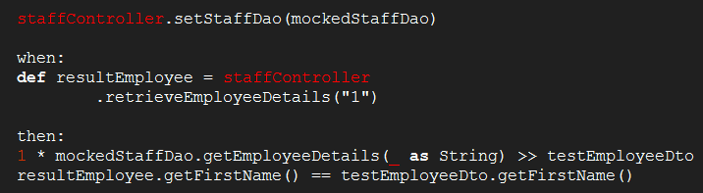
New Features BY Spock (Contd..)
Mocking using
Spock Framework:

Slide 27
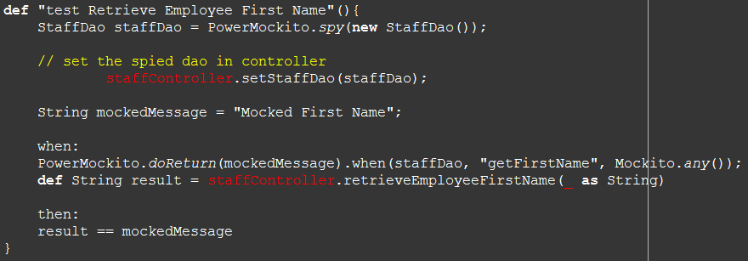
New Features BY Spock (Contd..)
Spock-PowerMockito Integration

Slide 28
Upcoming Hot Techinars
GitHub
Git
MongoDB
Hadoop
Pig Latin
Vagrant
Docker
NodeJS

Slide 29
3rd Party Libraries:
Junit 4 → Ver: 4.11 Jar: junit-4.11.jar
Spring Framework → Ver: 4.1.0.BUILD-SNAPSHOT
spring-test
spring-context
Spring-core
Power Mock → Ver: 1.5.5 License: Apache License 2.0
powermock-module-junit4
powermock-api-mockito
powermock-module-junit4-rule-agent
Spock Framework → Ver: 0.7-groovy-2.0 License: Apache License 2.0
spock-core
spock-spring
Cglib-nodep → Ver: 2.2.2 License: Free S/w.
Junit Params → Ver 1.0.2 License: Apache License 2.0

Slide 30
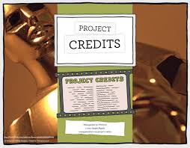

Slide 31
Junit Topic suggestion: Prakash Krishnamurthy
Spock Framework Topic suggestion: Jiji James

Slide 32


Slide 33


Slide 34

References

Slide 35
References
Kushal. (April 26, 2014) “10 Differences Between JUnit 3.x and JUnit 4.x and why you should move to JUnit 4.x platform”[Blog Post]. Retrieved from http://www.sanjaal.com/java/981/java-unit-testing-and-junit/10-differences-between-junit-3-x-and-junit-4-x-and-why-you-should-move-to-junit-4-x-platform/.
Vogel, Lars. (October 28, 2013) “Unit Testing with JUnit – Tutorial”[Website]. Retrieved from http://www.vogella.com/tutorials/JUnit/article.html.
Johnson,R. , Hoeller, J. , Donald K. , Sampaleanu C. , Harrop, R. , Thomas Risberg, T. , Arendsen, A., . . . Deleuze S.(2014) “Spring Framework Reference Documentation”. Retrieved from http://docs.spring.io/spring/docs/4.1.0.BUILD-SNAPSHOT/spring-framework-reference/htmlsingle/.
Johan, Jan (2014) “Power Mock”[Google Project Hosting]. Retrieved from https://code.google.com/p/powermock/
Peter Niederwieser (2012) “Spock Framework Reference Documentation”[Google Project Hosting]. Retrieved from https://code.google.com/p/spock/

Slide 36


